Slide 1
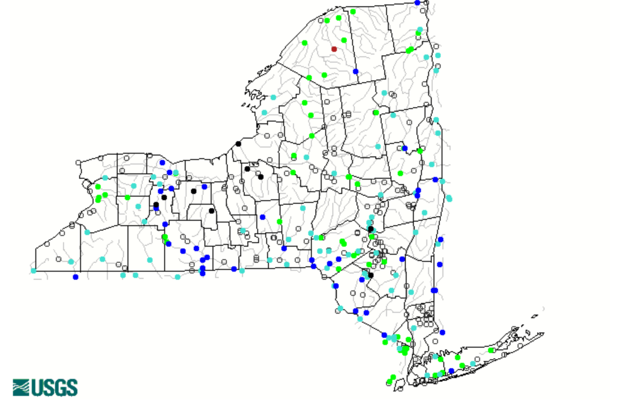
Green Island Stream Gage

Slide 3
Seasonal Center of Flow Volume – Day of the year when more than 50% of the total volume for that season has gone past the station.

Slide 4
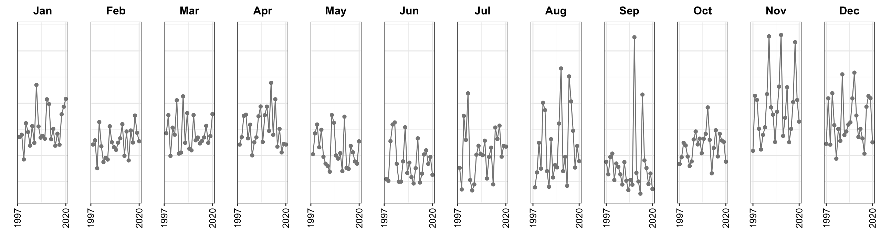
2.2
mg/m³
0.62

Slide 5
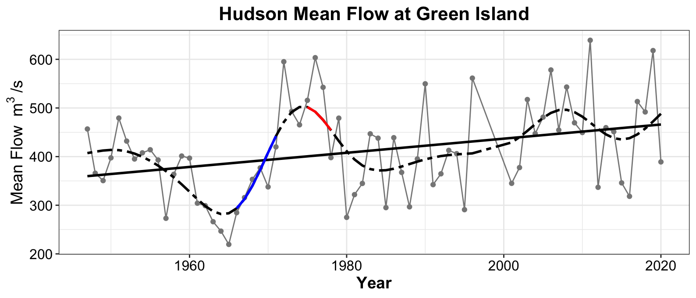
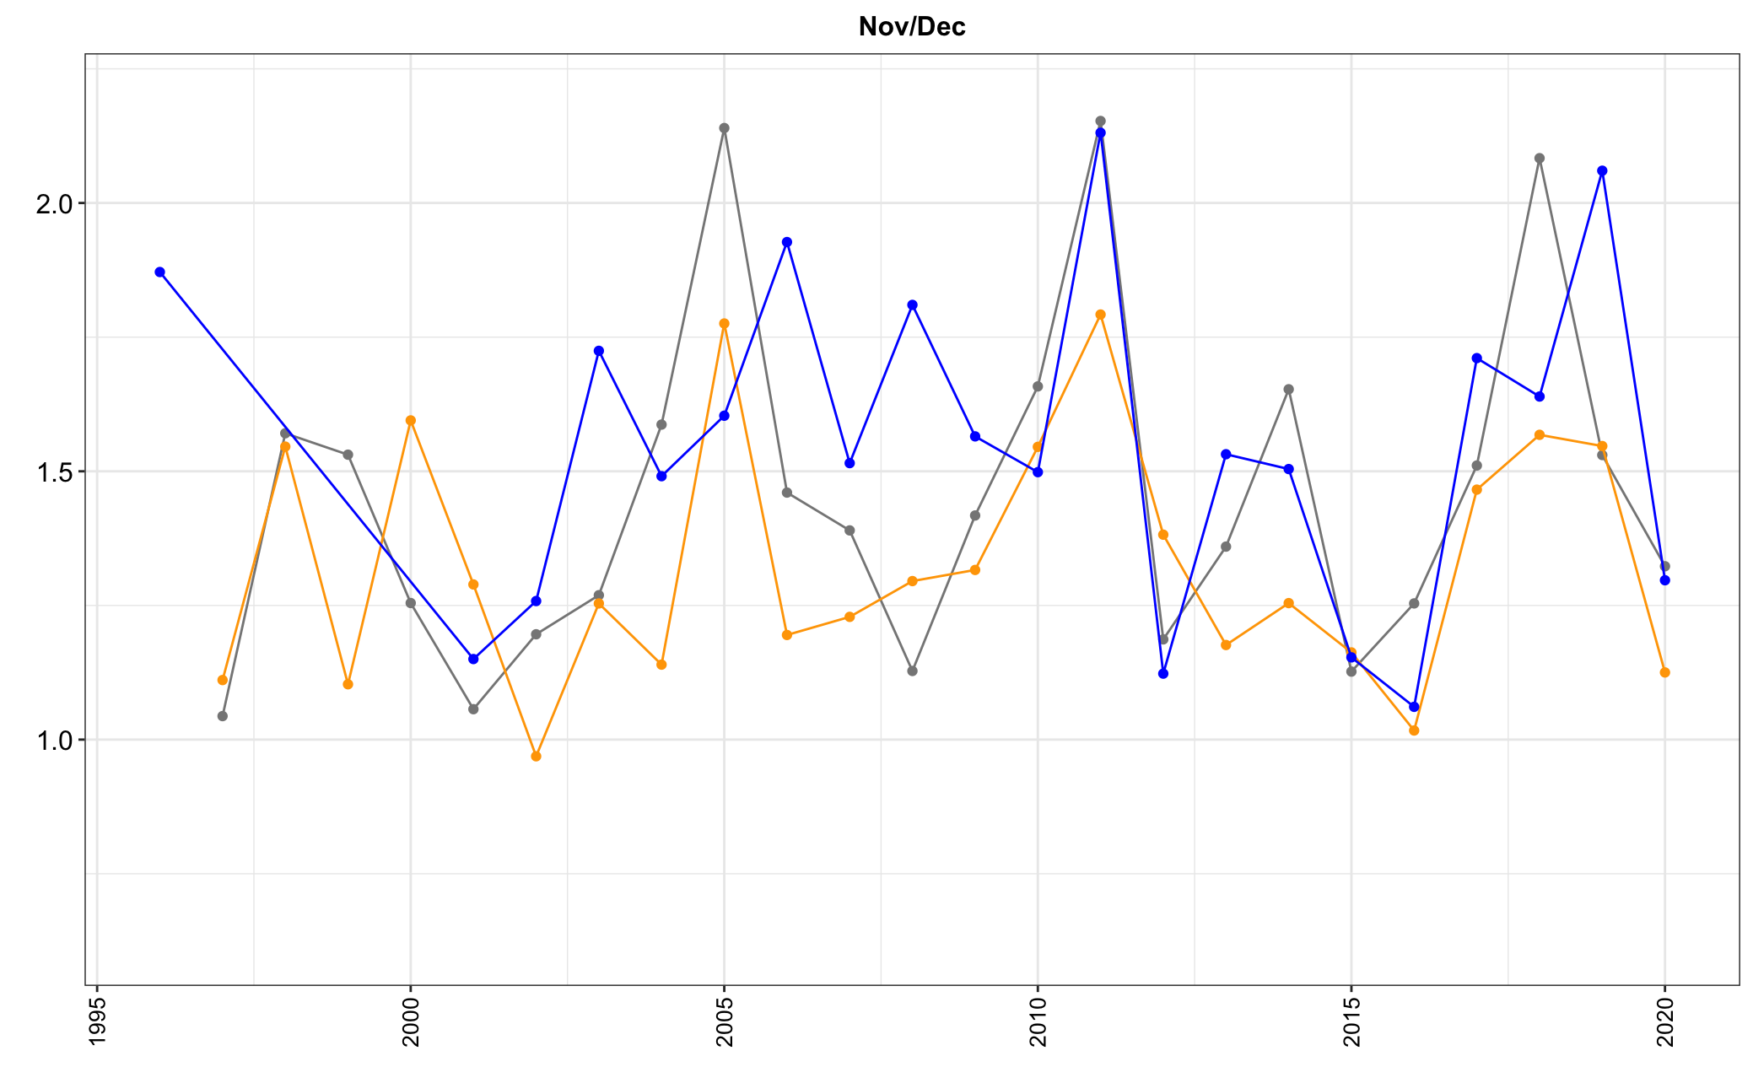
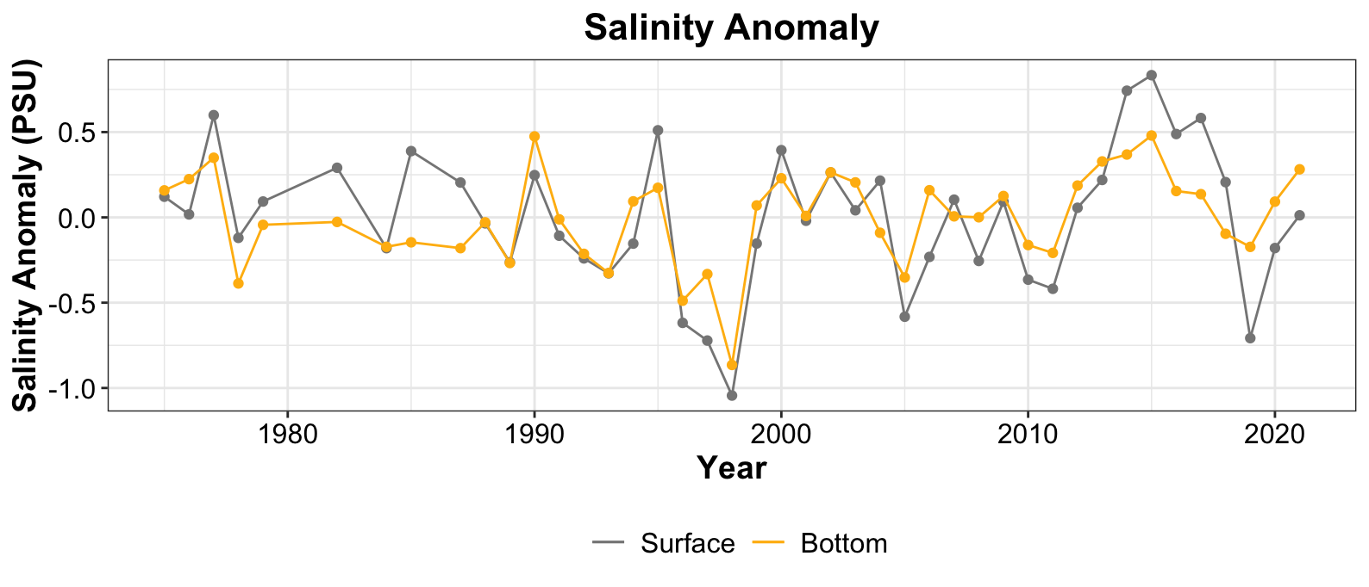
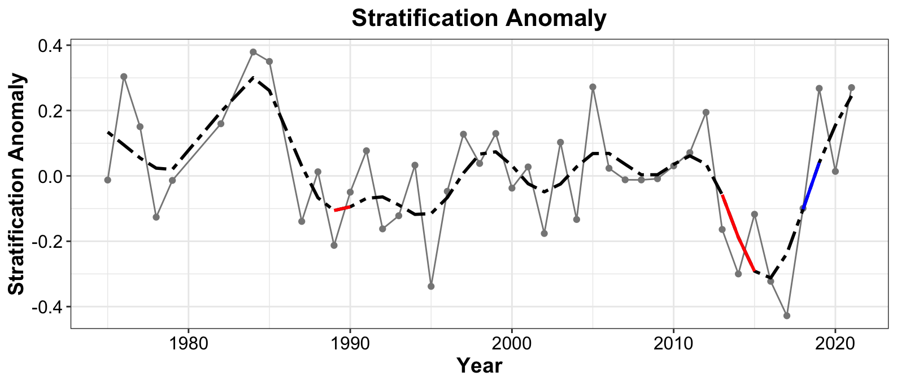
Chla Nov
Hudson
Chla Dec
Hudson, Chla Nov r=0.5
Hudson, Chla Dec r=0.6

